Slide 1
VISION-BASED LANE DETECTION AND CONTROL PIPELINE
Team 6
Raspberry Pi + Camera
Hardware Control

Slide 2
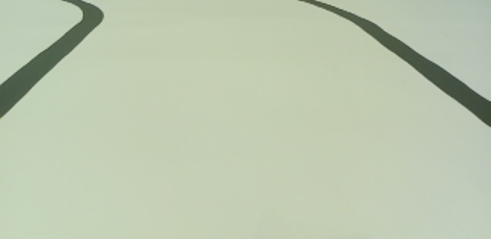
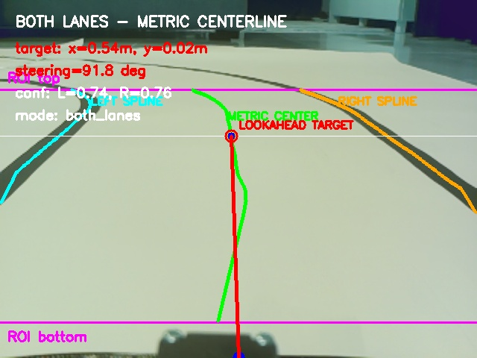
Project Objective & System Architecture
From camera frame to vehicle actuation in one ROS 2 pipeline.
Objective
Enable a small autonomous vehicle to follow a printed black-lane track on a white background using a real-time camera-based pipeline.
Core idea
The algorithm does not only draw lanes. It produces a real-world lookahead target that the pure pursuit controller can use directly.
Input ROI
Camera
Lane node
Metric target
Pure pursuit
Arduino output
Controller-ready overlay

Slide 3
Homography Calibration Process
Four reference points were selected on the lane track.
Image pixel coordinates were mapped to real-world ground coordinates in meters.
Homography removes camera perspective distortion caused by the camera angle.
Converts image targets into:
  Forward distance (x)
  Lateral offset (y)
Enables metric centerline calculation instead of pixel-only estimation.
Improves pure pursuit steering accuracy and vehicle stability.

Slide 4
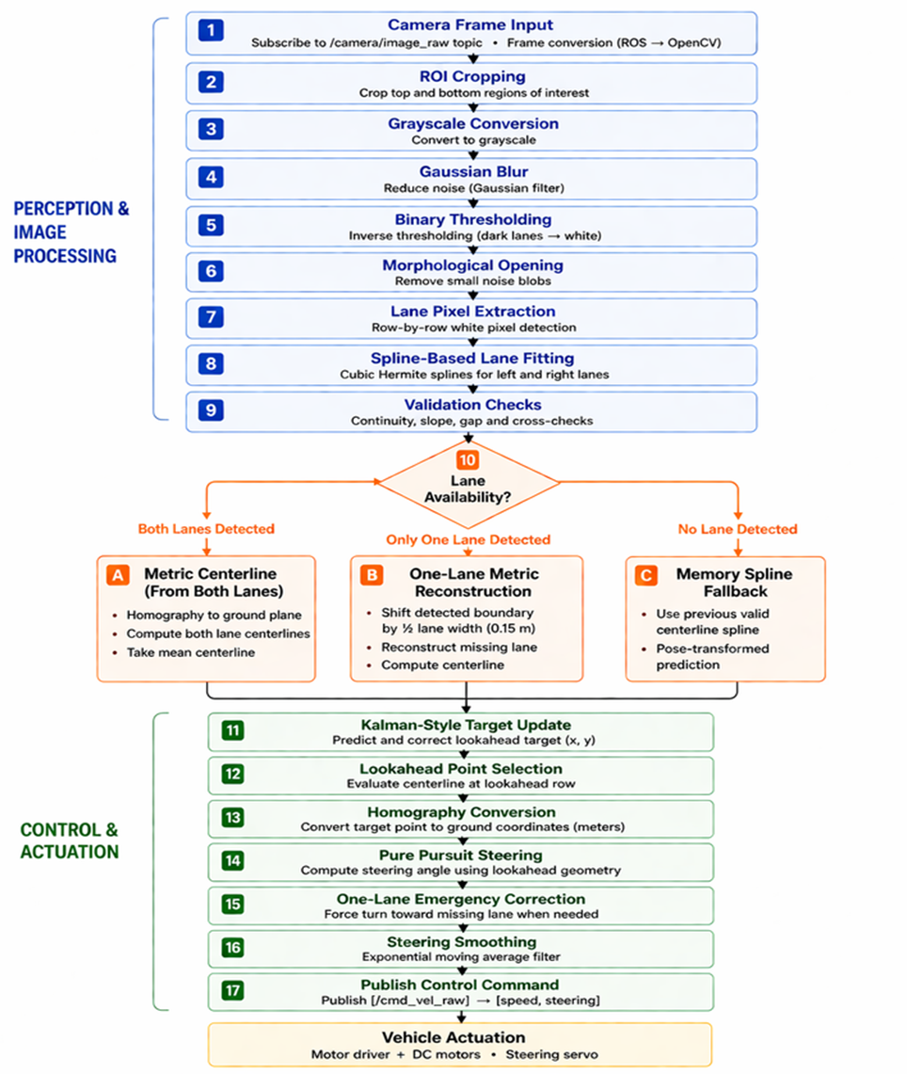
End-to-End Pipeline
Perception first, then control and actuation.
Important processing stages
1–5 Camera input, ROI cropping, grayscale, blur, and binary thresholding.
6–9 Morphological cleanup, row-by-row extraction, spline fitting, and validation.
10 Lane availability decision: both lanes, one lane, or memory fallback.
11–17 Target smoothing, homography, pure pursuit steering, and command publishing.
Reported system performance
20.82 FPS
38.57 ms
100%
70.02%
Real-time processing rate
Average latency per frame
Target availability
Dual-lane detection rate
Tested under varied lighting and lane scenarios: dual lane, single lane, and no-lane cases.

Slide 5


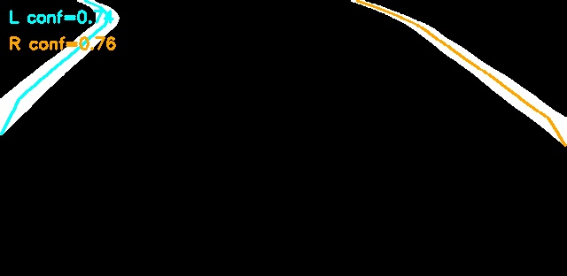
Frame 1: Full Detection Flow
Images 1–5 show how raw camera data becomes a steering-ready lane target.
Main result
1 Raw ROI
2 Binary threshold
3 Morphological opening
4 Spline fit
Why it matters
Final overlay: metric centerline, lookahead target, steering value, and confidence values.
Thresholding isolates black lane pixels; morphology removes noise; splines create smooth boundaries for target selection.

Slide 6
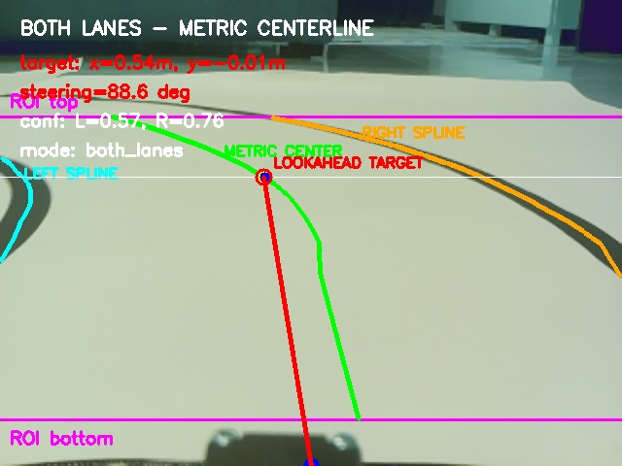
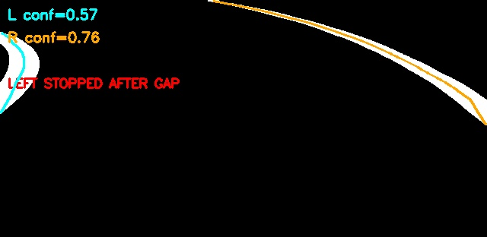
Frame 2: Dual-Lane Tracking
Images 6–7 show tracking on a curve with both lane boundaries available.
Spline-only debug view
Key behavior
• The left and right splines are validated before use.
• The centerline is calculated in metric ground space.
• A lookahead target is selected on the centerline and sent to pure pursuit.
Final overlay

Slide 7
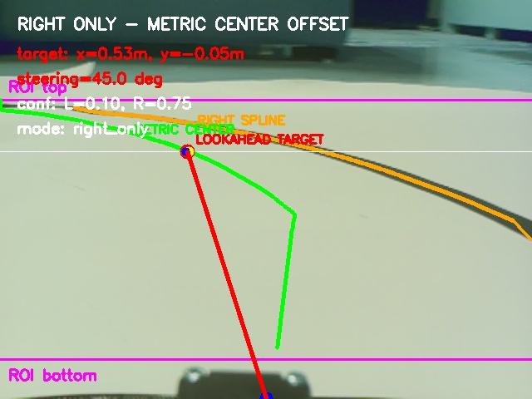
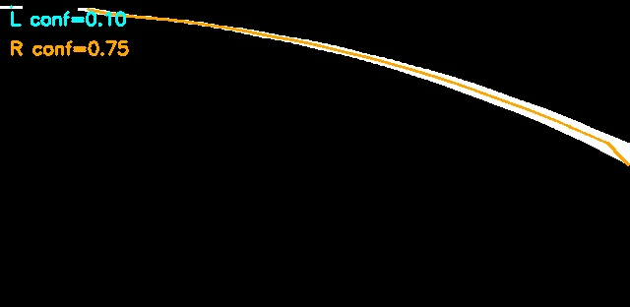
Frame 3: One-Lane Recovery
Images 8–9 show operation when only one lane boundary is reliable.
Spline-only debug view
Fallback logic
• Missing lane is reconstructed using the real lane width.
• Right-only mode shifts the boundary by 0.15 m to estimate the centerline.
• Emergency steering correction prevents the vehicle from drifting away.
Right-only overlay

Slide 8
Control Output & Hardware Actuation
The pipeline ends with a command that the microcontroller can execute.
Output command
Important final parameters
/cmd_vel_raw = [speed, steering_angle]
ROI crop
top 25%, bottom 10%
Dark threshold
125
Servo convention: 90° = straight, 45° = max left, 135° = max right.
Lane width
0.30 m
Wheelbase
0.255 m
Target point
Pure pursuit
Steering
Actuators
Drive speed
0.7
Smoothing α
0.9
One-lane forced turn
35°
Hardware chain
Raspberry Pi runs ROS 2 and the camera pipeline. Arduino receives speed and steering commands, then drives the DC motor driver and steering servo.
Common ground is required between Raspberry Pi / Arduino / motor driver when signals are exchanged directly.

Slide 9
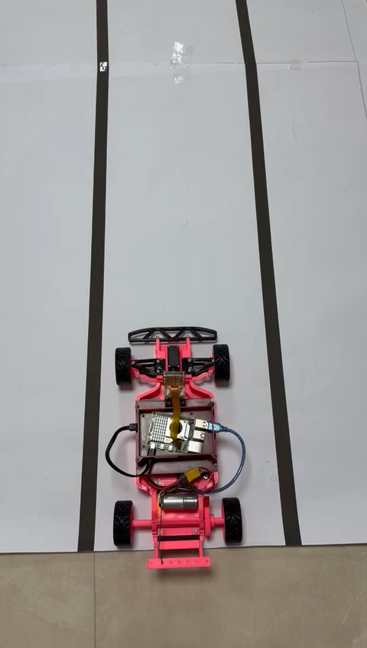
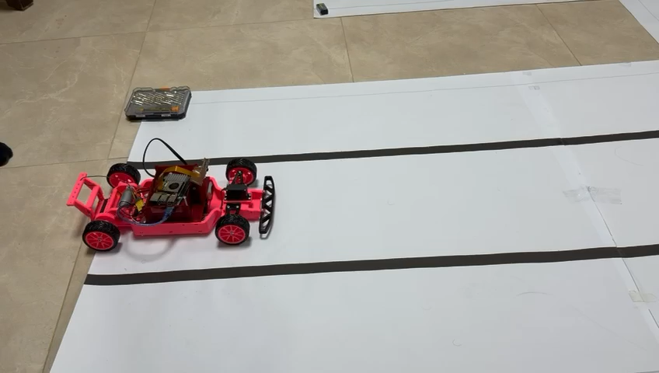
Video Demo
.

